Slide 2


Slide 3
Origin Of HBase
GFS
MAP REDUCE
BIG TABLE
Apache HDFS
Apache MAP REDUCE
Apache HBase

Slide 4
WHAT IS HBase?
Similar to Google’s Big Table
Open Source Project, Coloumn Oriented NoSQL Database
Written in Java
Runs at the top of HDFS

Slide 5
WHY HBASE?
HBase is fast
Can handle sparse data
Random access
Schema can be changed

Slide 6
FEATURES
Linearly Scalable
Automatic Failure Support
Integration with Hadoop
No Datatype Problem
Data Replication

Slide 7
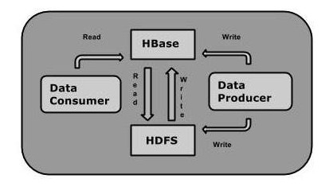
RELATION WITH HDFS

Slide 8
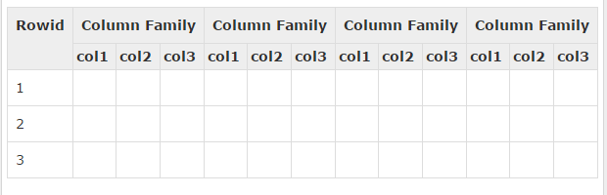
DATA HANDLING
Stored in form of tables
Contain Row keys and Coloumn Families

Slide 9
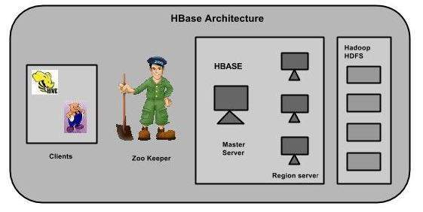
ARCHITECTURE

Slide 10
COMPONENTS
HMaster
Region Server
Client Library

Slide 11
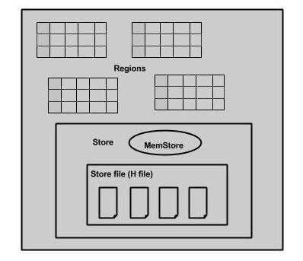
HBASE WORKING

Slide 12
IMPORTANT TERMS
Regions
Stores
Memstore
Hfile
WAL(Write Ahead Log)

Slide 13
DIFFERENCE B/W HBASE & RDBMS
HBASE
RDBMS
Supports Scale Out
Uses API and MapReduce to access data
Schema is flexible
Suitable for both structured and non structured data
This is always distributed
Supports Scale Up
Uses SQL Queries
Schema is more restrictive
Suitable for structured data
This is centralized

Slide 14
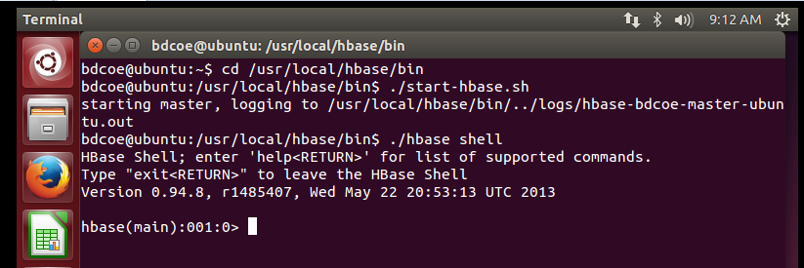
HBase Shell

Slide 15
Creating Table

Slide 16
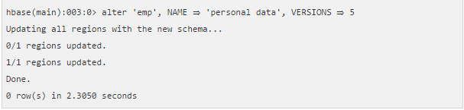
Alter Table

Slide 17
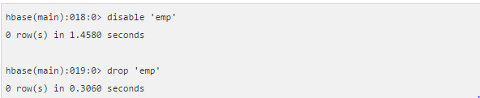
Drop(Delete) Table

Slide 18
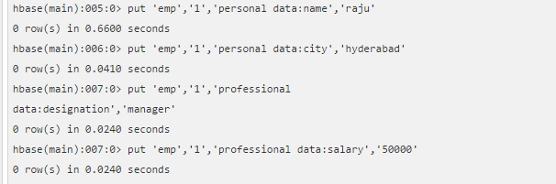
Adding Data

Slide 19
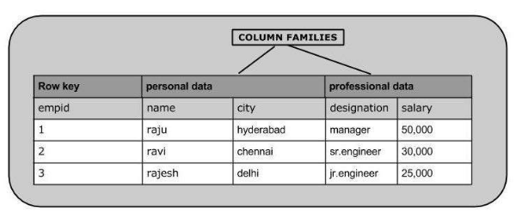

Slide 20
Update Table

Slide 21
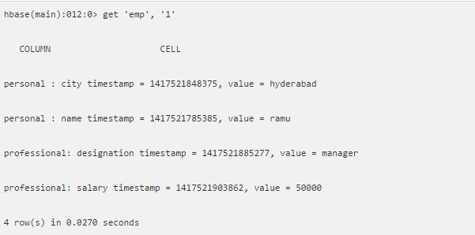
Read Data

Slide 22

Delete Data

Slide 23
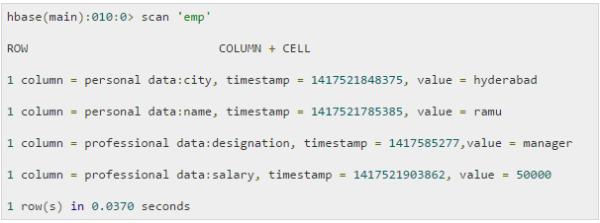
View Table

Slide 24
USES
Facebook messenger
Twitter
Adobe
Netflix
Yahoo
And many more like Flurry , Spotify , Imgur

Slide 25
THANK YOU
Presented By
Lavish jain
Ankit gupta
Aman aggarwal

